Slide 1
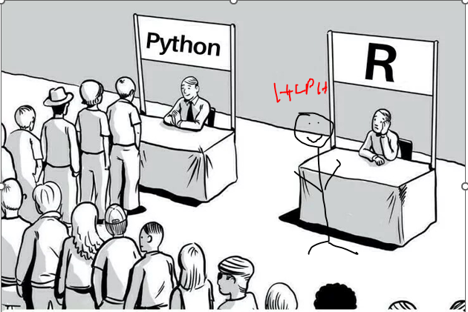

RI R Learning Sessions
By: RI Team Date: TBD

Slide 2
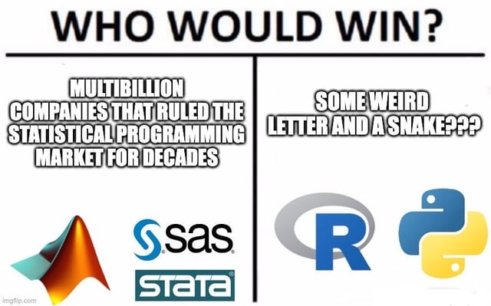
Learning Session General Info
Occur every other week, subjected to change
45 mins total
30 min tutorial
15 mins for questions
Will be recorded
Weeks at a glance [subjected to change]-
Week 1: intro to R, import, and clean
Week 2: more cleaning, calculations
Week 3: datetime
Week 4: functions functions
Week 5: reusing code properly/debugging
More session based on audience request

Slide 3
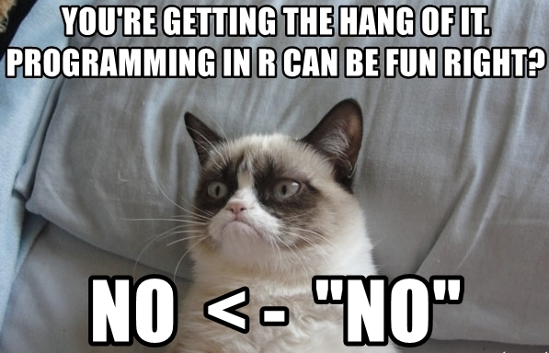
Session 1: intro to R, import, and clean
Learning session inspired from these books: https://epirhandbook.com/new_pages/cleaning.html & https://r4ds.hadley.nz/data-transform
Library that we will use (toolset analogy)
Tidyverse (library are toolsets, functions within are tools)
Janitor
Time to clean, (instruct with R example)
Learn how to read documentation for x library/x function! Documentation are like instruction manuals.

Slide 4
Session 2: Intro to R two hr training
No slide was created, pls refer to recording in sharepoint or referred books.

Slide 5
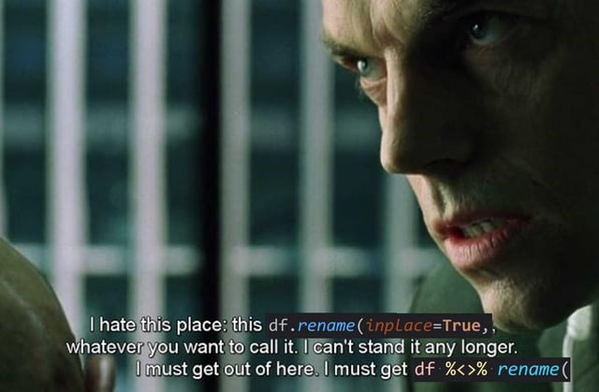
Session 3: more cleaning, column calculation/manipulation
Library that we will use
Tidyverse
insight
Time to clean, (instruct with R example)
Will go over case_when(), mutate, rowMeans, if statement
Will also review object for x function per documentation
If statement will be use for QA

Slide 6
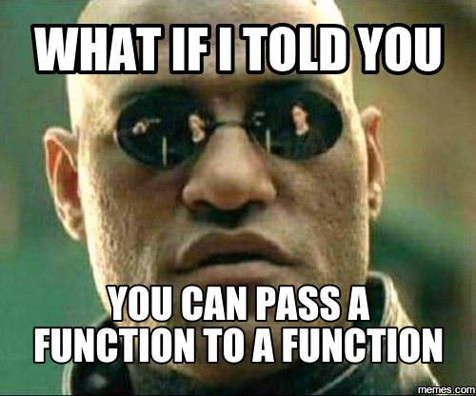
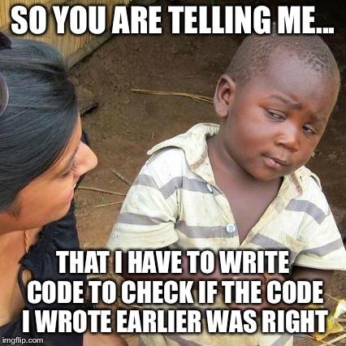
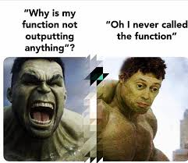
Session 4: Functions 0.o
Library that we will use
Tidyverse
Read up on: https://r4ds.hadley.nz/functions
Functions help with repetitive task. They are like blueprints for code logic.
Ex: u need x values for y report every quarter so you use a function to minimize code repeats.
Make sure you qa your function for unexpected results
Also, not everything needs to be written in a function, sometimes its best to get the output then work on the function later if needed.

